Slide 1
Module No 5
UiPath Application Automation

Slide 2
Learning Objective
Working with excel
Exception Handling

Slide 3
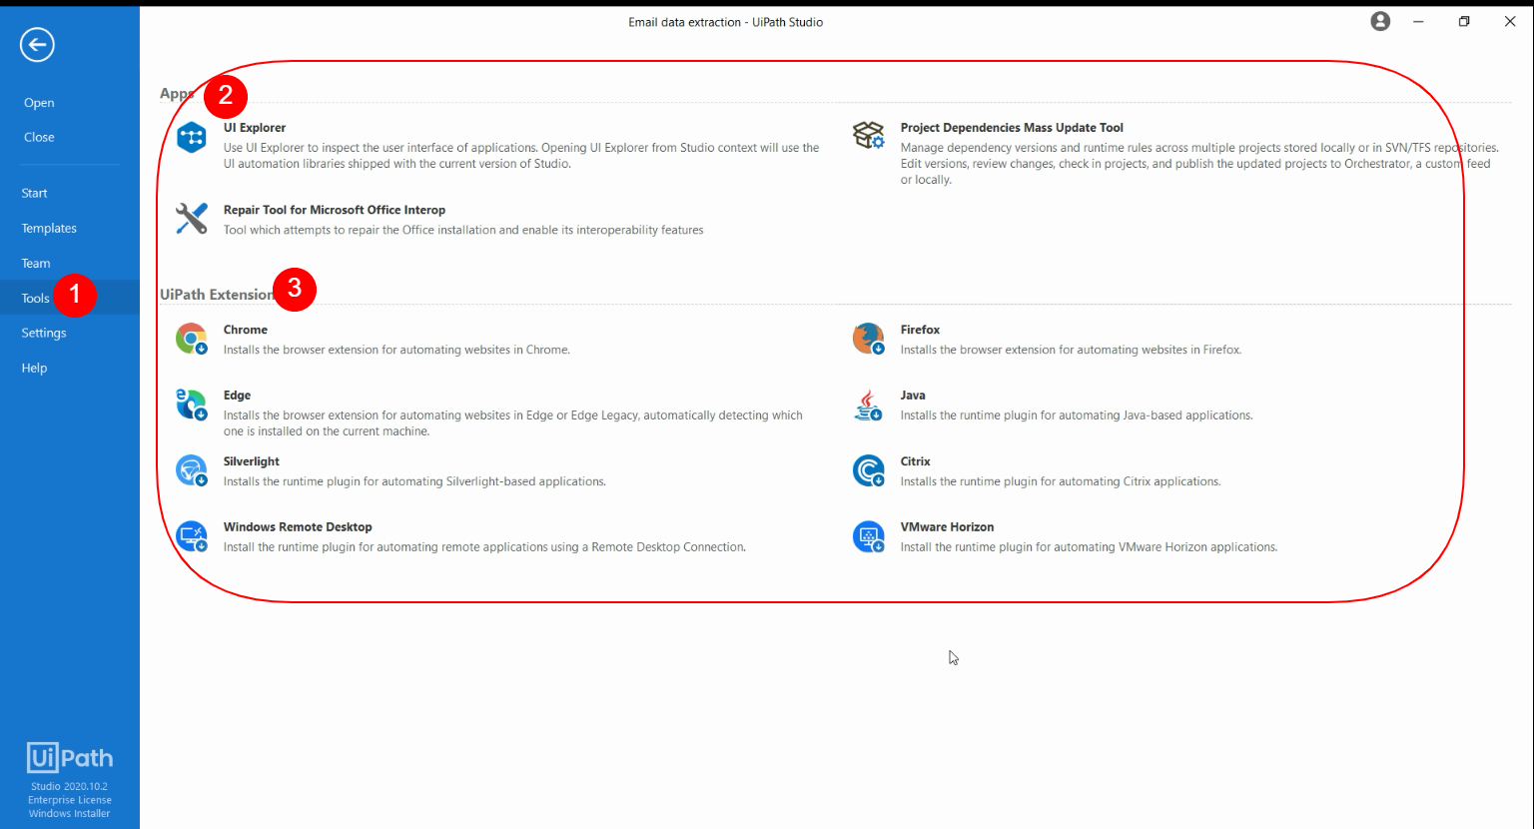
Plugins and Extensions
UiPath has many plugins and extensions to ease UI automation, apart from basic extraction and interaction with the desktop screen. These plugins allow us to directly interact with those applications or ease UI automation. Some of the important sections that are going to be covered in this course are:
Terminal plugin
SAP Automation
Web integration (UI Explorer)
Excel and Word plugins (Repair tool for Office)
Extensions: Java, Chrome, Edge, Firefox, and Silverlight, Citrix Automation, RDP, VMWare

Slide 4
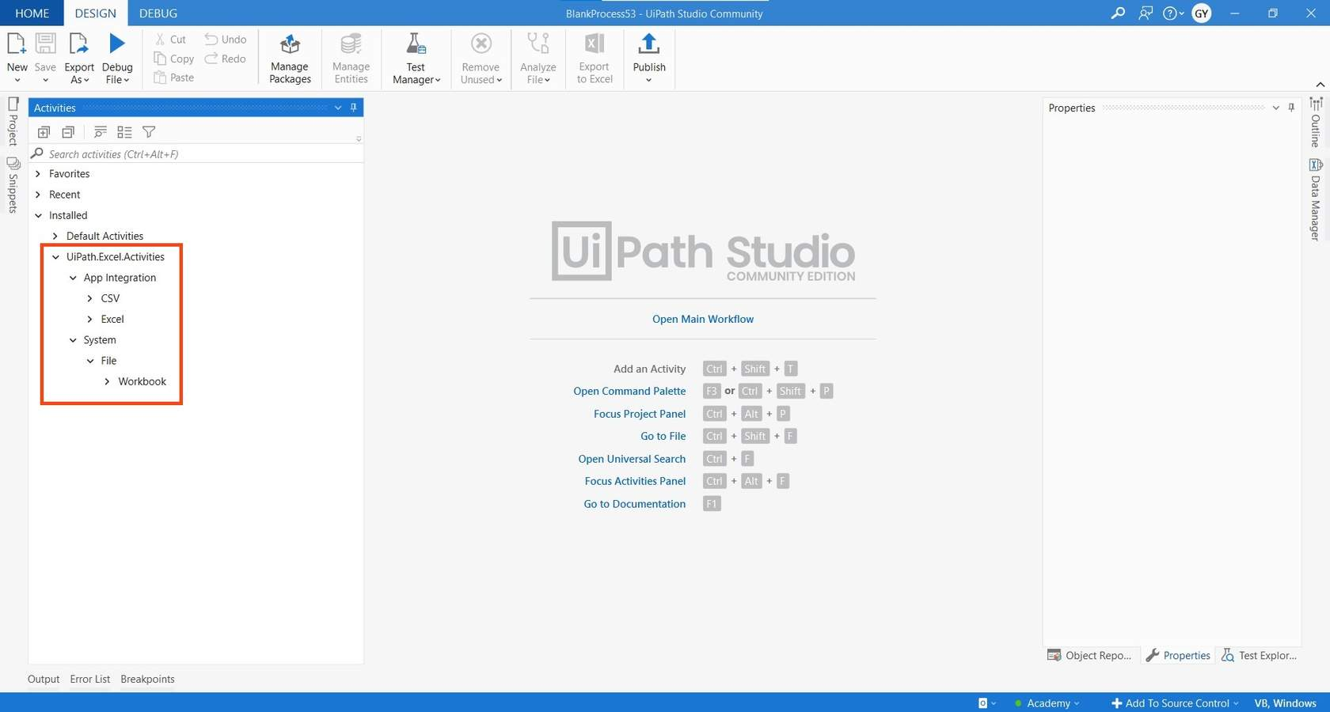
Working with Excel
UiPath Studio provides a comprehensive set of activities and features to automate various tasks, including Excel automation. This includes the UiPath.Excel.Activities package, which contains a wide range of activities for reading and writing data, formatting cells, filtering and sorting data, creating charts and graphs, and performing calculations in Excel.
UiPath Studio offers two ways for accessing and manipulating workbooks/Excel.
1 - Workbook or File Access Level
2 - Excel or Excel App integration

Slide 5
Working with Excel
UiPath Excel Automation brings you countless automation possibilities, no matter how small or elaborate the tasks you are doing on your day to basis such as Reading and Writing data, Data Extraction from other source and Managing them in sheets or Copying columns values to other application and so on …
The UiPath Excel activities package aids users to automate all aspects of Microsoft Excel, as we know it is an application intensely used by many in all types of businesses.
It contains activities that enable you to read information from a cell, columns, rows or ranges, write to other spreadsheets or workbooks, execute macros, and even extract formulas. You can also sort data, color code it or append additional information.
The activities grouped under the System chapter can be executed even if Microsoft Excel is not installed on the machine,
whereas the ones under the App Integration chapter require the app on the machine on which they run.
In this module, we are going to operate on Excel file. In particular following are the methods that are frequently used with an Excel file:
Read cell
Write cell
Read range
Write range
Append range
Once you get familiar with these methods, it will become very easy for you to use other methods too.

Slide 6

Working with Excel(App Integration)
Append To CSV
Read CSV
Write CSV
Delete Column
Filter Table
Get Table Range
Insert Column
Sort Table
Append Range
Close Workbook
Excel Application Scope
Get Cell Color
Read Cell
Read Cell Formula
Read Column
Read Range
Read Row
Select Range
Set Range Color
Write Cell
Write Range
Save Workbook
Create Table
Get Workbook Sheet
Get Workbook Sheets
Refresh Pivot Table
Create Pivot Table
Get Selected Range
Copy Sheet
Delete Range
Auto Fill Range
Copy Paste Range
Execute Macro
Insert/Delete Columns
Insert/Delete Rows
Invoke VBA
LookUp Range
Remove Duplicates Range
All activities used to work with Excel in UiPath are derived from the UiPath.Excel.Activities package.
This section includes App Integration related activities found in the UiPath.Excel.Activities pack.
Activities gets updated with Release cycle of UiPath…Hence follow latest UiPath Documentation for updated guide..

Slide 7

Working with Excel (System Integration)
Append Range
Get Table Range
Read Cell
Read Cell Formula
Read Range
Read Row
Write Cell
Write Range
Why is Difference Between System Integration Workbook Vs Excel Application Scope…
Activities gets updated with Release cycle of UiPath…Hence follow latest UiPath Documentation for updated guide..

Slide 8
Criteria | Workbook Activities | App Integration Activities
Excel Installation Required | No | Yes
Compatibility | Works with .xlx and .xls | Compatible with .csv, .xlsx, .xls, and .xlsm
Functionality | Limited to basic Activities | Wide range of Activities
Advantages | Can be executed in the background without opening the Excel application, resulting in faster and more reliable operations | Can perform a wide range of operations, including advanced Excel features such as macros and pivot tables
Working with Excel (System Integration)

Slide 9
Trainer will give quick demo to work with Excel Activities..

Slide 10
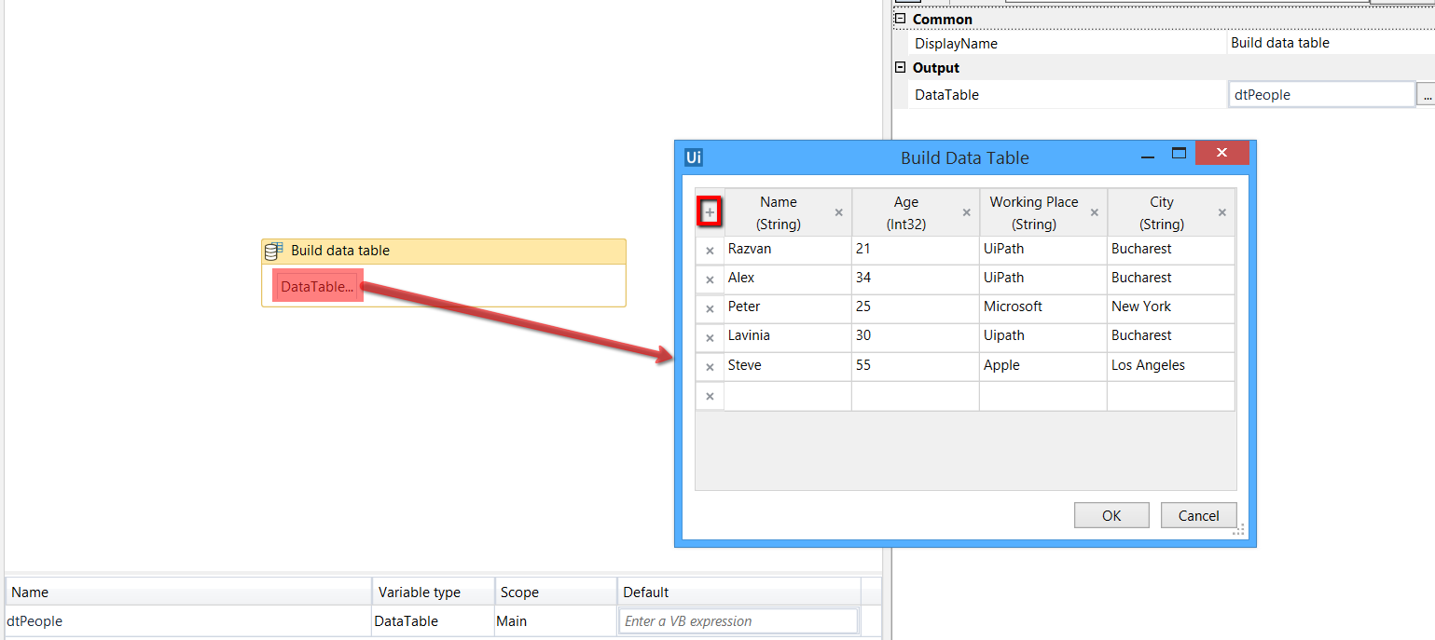
DataTable Usage with examples
A data table is a tabular form of data structure. The DataTable class in C# ADO.NET is a database table representation and provides a collection of columns and rows to store data in a grid form.
It contains rows and each row has columns, for example:
Name | Age | Working at
Sanjay | 20 | UiPath
Deepak | 23 | UiPath
Manjeet | 25 | UiPath
Monika | 19 | Apple
You will usually want to access every row in a table, and there is a built-in activity for looping through all of the rows in a DataTable named For Each Row.
Simply specify the name of the table that you will loop through, and the name of the row variable.

Slide 11
Why are DataTables important in Excel automation?
Why are DataTables important in Excel automation?
Efficient handling of large amounts of data: When working with large datasets, DataTables allow for more efficient handling of data, including sorting, filtering, and grouping.
Improved data accuracy: DataTables can be used to validate data and ensure accuracy before exporting to Excel, reducing the risk of errors or mistakes.
Programmatic manipulation of data: DataTables can be manipulated programmatically using various programming languages, allowing for more advanced data manipulation and analysis.
Better data organization: DataTables can help organize data in a structured format, making it easier to navigate and understand.
Integration with other systems: DataTables can be integrated with other systems or applications, allowing for seamless data transfer and analysis across different platforms.

Slide 12
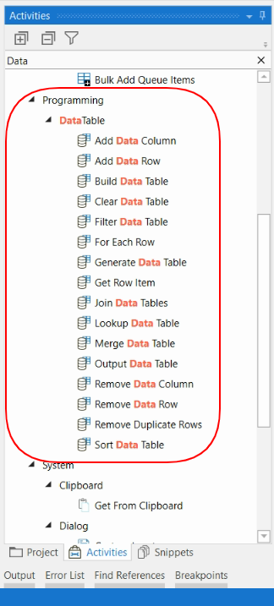
Data Table Activties
Add Data Column
Add Data Column activity lets you add a new column to an existing DataTable.
Add Data Row
Add Data Row is used to add a row to an existing DataTable.
Build Data Table
Build Data Table allows you to create a new DataTable from nothing, with the specified columns and rows. This is a great activity for testing your workflows.
Clear Data Table
Clear Data Table will remove all rows from a table, but preserve the columns.
Filter Data Table
Filter Data Table lets you specify a filter to grab certain rows from the table.
Generate Data Table
Generate Data Table builds a new DataTable from unstructured data.
Join Data Tables
Join Data Tables lets you combine the rows of two DataTables using a common key. It will attempt to match the tables on the column names in common between the two tables, and the remaining columns will all be available in the resulting DataTable.
Lookup Data Table
Lookup Data Table searches the table for a value in a specified column, and then returns the matching row or value from another specified column.
Merge Data Table
Merge DataTable combines the rows of two DataTables. The tables should have a matching or similar schema, meaning that it should have the same number of columns in the same type in the same order. You can handle differences in schema using the MissingSchemaAction property.
Output Data Table
Output Data Table turns a DataTable into a text string in the csv format. This is useful for debugging, for when you want to view the contents of a DataTable at a certain part of your automation.
Remove Data Column
Remove Data Column removes the specified DataColumn from the DataTable.
Remove Data Row
Remove Data Row removes the specified DataRow from the DataTable.
Remove Duplicate Rows
Remove Duplicate Rows returns a new DataTable with no duplicated rows, so that the data in each row is unique.
Sort Data Table
Sort Data Table sorts a DataTable in a order on the specified DataColumn.

Slide 13
Trainer will give quick demo to work with Datatable Activities..

Slide 14
Date Formatting's
Format | E.g., Result
DateTime.Now.ToString("dd/MM/yyyy") | 12/08/2022
DateTime.Now.ToString("MM/dd/yyyy") | 08/12/2022
DateTime.Now.ToString("dd/MMM/yyyy") | 12/Aug/2022
DateTime.Now.ToString("dd/MMMM/yyyy") | 12/August/2022
DateTime.Now.ToString("dd MMMM yyyy") | 12 August 2022
DateTime.Now.ToString("dd/MM/yyyy hh:mm:ss tt") | 12/08/2022 10:08:21 PM
DateTime.Now.ToString("dd/MM/yyyy HH:mm:ss") | 12/08/2022 22:10:08
DateTime.Now.ToString("hh:mm:ss tt") | 10:11:32 PM
dd - Represents the day of the month i.e., 03,05,18 or 30
MM - Represents the month number with leading zero i.e., 01,08 or 12
MMM - Represents the abbreviated month Name i.e., Jun, May or Dec
MMMM - Represents the full month name i.e., April, June or December
yyyy - Represents the year i.e., 2022
hh - Represents the 12-hour clock with a leading 0 i.e., 07,02 or 12

Slide 15
Methods for Date Formatting
DateTime.ParseExact Method
Convert.ToDateTime Method
ParseExact(String, String, IFormatProvider)
Parameters
String - A string that contains a date and time to convert.
Convert.ToDateTime(String)
Parameters
String - The String representation of a date and Time.
Returns
DateTime
Example
Convert.ToDateTime(“08/12/2022”)
Provider - An object that supplies culture-specific format information about String.
Returns DateTime
Example
DateTime.ParseExact("12/04/2022", “dd/MM/yyyy”,
System.Globalization.CultureInfo.InvariantCulture)

Slide 16
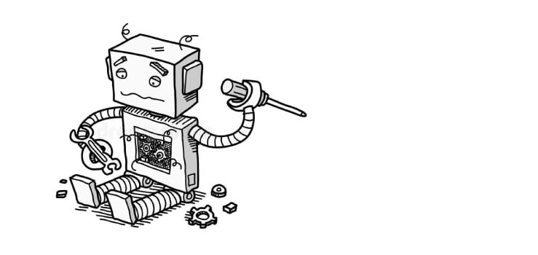
Advance Exception Handling
Sometimes, automation program may fail to execute. To deal with such cases, we use exception handling activities.
In this section, we start with the various types of exception handling method available in UiPath, the exceptions that you may encounter, and how to deal with them.
We will also learn about logging. An important topic covered is debugging to check whether workflows are working properly or not and to rectify any errors.
Before we begin, let us look at the topics that will be covered in this chapter:
Exception handling
Common exceptions and ways to handle them
Logging and taking screenshots
Debugging techniques
Collecting crash dumps
Error reporting

Slide 17


Exception Handling
Errors are events that a particular program can’t normally deal with.
Exceptions are events that are recognized (caught) by the program, categorized, and handled.
System Exceptions
Business Exceptions

Slide 18
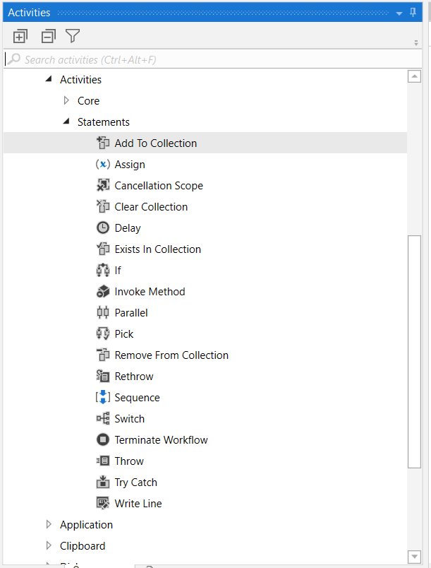
Exception Handling Activities in UiPath
Exception Handling mainly deals with handling errors with respect to various activities in UiPath. The Error Handling activity offers four options: Rethrow, Terminate Workflow, Throw, Try Catch.
Below are the key points for exception handing .
Rethrow : – it is used when you want activities to occur before the exception is thrown.
Terminate Workflow :- workflow is used to terminate the workflow the moment the task encounters an error.
Throw :- This activity is used when you want to throw error before the execution of the step.
Try Catch :- This activity is used when you want to test something and handle the exception accordingly. So, whatever you want to test you can put it under the try section, and then if any error occurs, then it can be handled using the catch section, based on your input to the catch section. Apart from the try-catch, we also have a Finally section which is used to mention those activities which have to be performed after the try and catch blocks are executed.

Slide 19
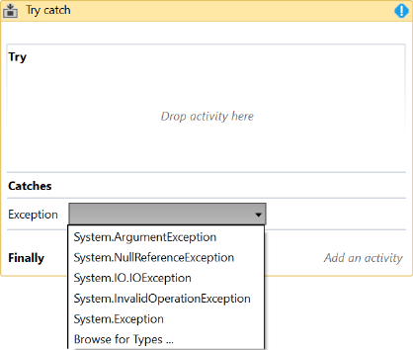
Try Catch
Holds the activity(s) that could throw an exception.
Specifies the exception type and, optionally, holds an activity that informs the user about the found exception. (e.g. Log message, Send mail)
Holds the activity(s) that should be executed whether when an error is caught (without being re-thrown) or Try block executed successfully.

Slide 20


Throw & Rethrow
Throws a custom error.
new BusinessRuleException("message As String")
new ApplicationException("message As String")
Throws an exception previously caught in an exception handling block.
●
Must be the child of a Catch handler of a TryCatch activity.

Slide 21
Common exceptions and ways to handle them
Selector Not Found/UI Element no found issues
Exception Type: UiPath.Core.SelectorNotFoundException
Image not found
Exception Type: Uipath.Core.ImageOperationException : Image Not Found
Activity timeout exceeded issue
Exception Type: UiPath.Core.ElementOperationException: Timeout reached
Object reference not set to the instant of an object
Mostly due to selectors captured during the development are breaking. Check your Selectors.
Exception Type: System.NullReferenceException
The main reason of this kind of issue is when you run the job from orchestrator, it connects to Remote Environment (Your runtime robot) with a different screen resolution as compared to the screen resolution you could have used to develop the automation workflow. Check your resolution.
This error usually occurs when using a variable with no set value (not initialized).
The error “Timeout reached” occurs when the robot is waiting for some elements to appear on the screen and the element is not available on the screen even after the 30sec(default).

Slide 22
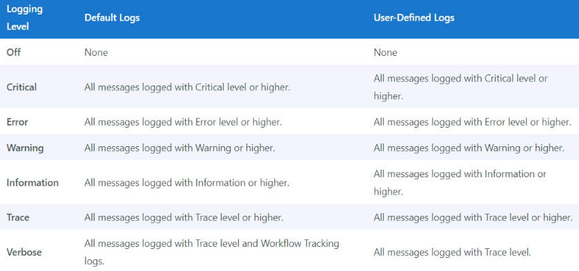
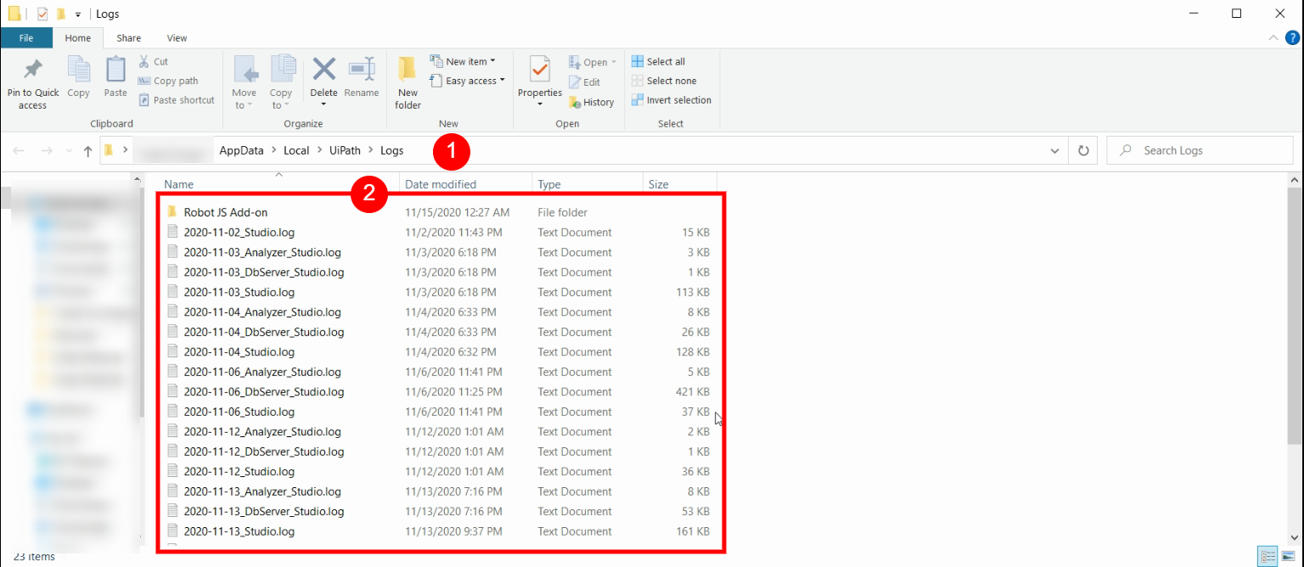
Logging and Taking screenshots
For client logging in UiPath, we have an NLog configuration file which makes it easy and flexible to integrate with databases, servers, or any other NLog targets. It can be send to log aggregators like elastic search for data visualization using Kibana.
By default, these Logs are saved in -%Local App %\UiPath\Logs
All logs generated by the execution are also sent to the server.
Each Log has a Log Level which refers to how detailed the generated message is.
Logging Levels refer to the type of severity that is written in the Log File.
Logs can be exported and searched from UiPath Orchestrator

